Slide 1
Child Outcomes Summary (COS) Process Module
Session 1:
So What’s This All About?
Notes:
Welcome. This presentation provides early intervention and preschool special education staff with an introduction to the Child Outcomes Summary process. This information sets the stage for understanding the type of child outcomes data programs collect and how those data can support the overall goal of improving outcomes for children and families.

Slide 2
Background
U.S. Department of Education
Office of Special Education Programs (OSEP)
$438 million – Early Intervention
$350 million – Preschool Special Education (2014)
Outcome measures help determine if federal funding through IDEA is making a difference for young children with disabilities and their families.
Notes:
Let’s begin with a background on the origin of child outcomes.
The Office of Special Education Programs, or OSEP, in the US Department of Education provides states with substantial funding for the provision of early intervention and preschool special education. In 2014, states received more than $438 million for early intervention and $350 million for preschool special education services from the federal IDEA funding. Congress requires that the Department of Education provide information on whether these funds are making a difference for young children with disabilities and their families.
To that end, OSEP supported a stakeholder process to identify what outcomes should be measured for early intervention and preschool special education and what should be reported about those outcomes. Stakeholders, such as early intervention and preschool special education staff and administrators, families of children with disabilities, researchers, advocates, and others, provided input for over a year, between 2004 and 2005. After considering many alternatives, the stakeholders recommended that data be collected on three child outcomes. They also recommended that data be reported on five categories of progress that children make in these outcomes.

Slide 3
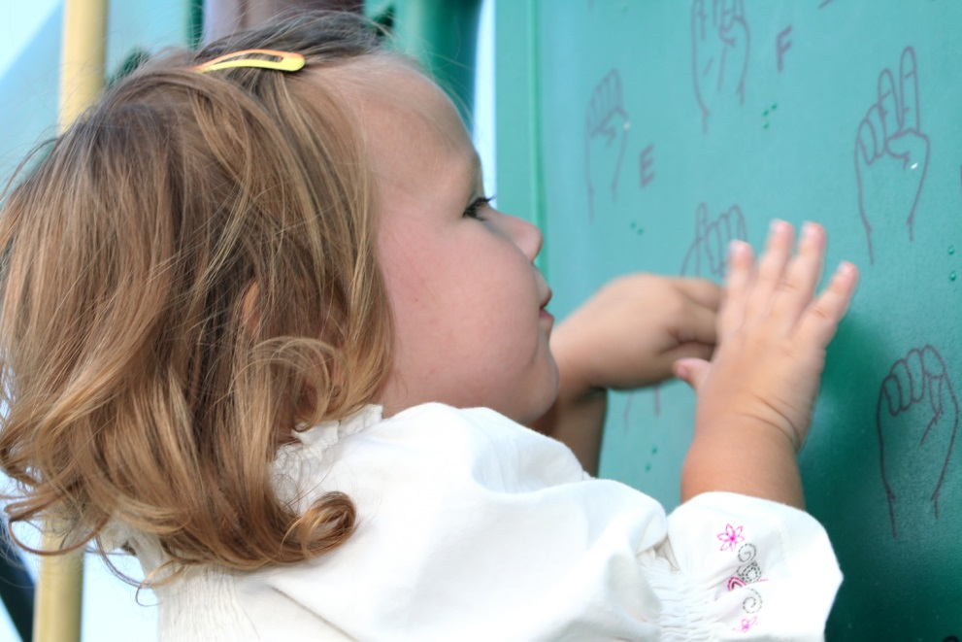
What is an Outcome?
an end result
Notes:
The requirement for data on child outcomes is part of a major shift in accountability for public programs. For many years, public programs, including early intervention and preschool special education, reported data to funders and taxpayers on things like how many children received services or how many hours of service they received. These data are important, but they don’t show whether programs are making a difference. For that, we need outcomes data.
An outcome is defined as an end result. For early intervention and preschool special education, an outcome would be how a child or family is doing at the beginning, during, and at the end of participation in a program. Because children continually acquire new skills, they experience a series of outcomes over time. An outcome is not the number or type of services children receive, but what children can do after receiving those services.
No one had ever articulated what outcomes early intervention and preschool special education were trying to achieve, so stakeholders were convened to develop them.

Slide 4
Goal of Early Intervention and Early Childhood Special Education
“To enable young children to be active and successful participants
during the early childhood years and in the future in a variety of
settings – in their homes with their families, in child care, in preschool
or school programs, and in the community.”
From Family and Child Outcomes for Early Intervention and Early Childhood Special Education, Early Childhood Outcomes Center (April 2005). http://www.fpg.unc.edu/~eco/assets/pdfs/eco_outcomes_4-13-05.pdf
Notes:
A critical theme emerged from the stakeholders’ discussions about what outcomes early intervention and preschool special education try to achieve. The theme was an overarching and extremely important goal for both early intervention and preschool special education programs—“to enable young children to be active and successful participants during the early childhood years and in the future in a variety of settings—in their homes with their families, in child care, in preschool or school programs, and in the community.” This goal encompasses a vision for what all families would want for their children. Achieving specific outcomes is important because this enables young children with disabilities to be full participants, which is the ultimate measure of success for early intervention and preschool special education.

Slide 5
Three Child Outcomes
Children have positive social-emotional skills (including social relationships).
Children acquire and use knowledge and skills (including early language/communication and early literacy).
Children use appropriate behaviors to meet their needs.
Notes:
On the basis of the stakeholders’ input, OSEP required all state early intervention and preschool special education agencies to report data on three child outcomes:
Children have positive social-emotional skills (including social relationships).
Children acquire and use knowledge and skills (including early language/ communication and early literacy).
Children use appropriate behaviors to meet their needs.

Slide 6
Children Have Positive Social Relationships
Involves
Relating with adults
Relating with other children
For older children, following rules related to groups or interacting with others
Includes
Attachment/separation/autonomy
Expressing emotions and feelings
Learning rules and expectations
Social interactions and play
Notes:
Let’s take a closer look at each outcome. The first outcome focuses on children having positive social relationships. This means having good relationships with adults and playing well with other children. It also includes being able to separate from an adult when dropped off at child care, expressing emotions and feelings appropriately, following rules and expectations in different settings, and sharing and taking turns.

Slide 7
Children Acquire and Use Knowledge and Skills
Involves
Thinking and reasoning
Remembering
Problem solving
Using symbols and language
Understanding the physical world
Includes
Imitation
Early concepts—symbols, pictures, numbers, classification, spatial relationships
Expressive language and other communication
Early literacy and numeracy
Notes:
The second outcome is that children acquire and use knowledge and skills. This outcome involves many skills that provide the foundation for later success in school such as thinking, reasoning, remembering, problem solving, understanding symbols, and learning new words. This outcome includes understanding the concepts of more and less and understanding the physical world, such as knowing that a ball will roll and ice will melt. The outcome also includes being able to repeat sounds, gestures, and words; expressive language and other communication skills; and, for older children, early literacy and numeracy.

Slide 8
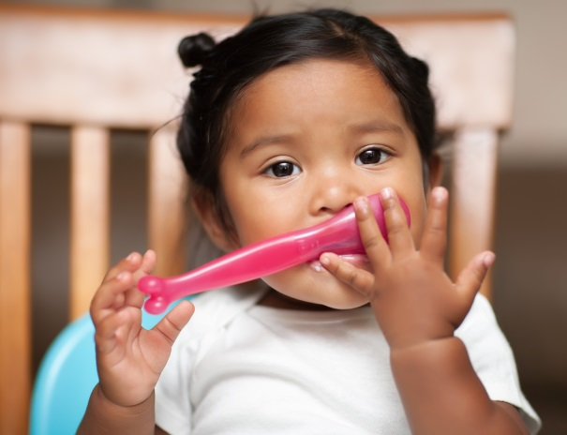
Children Take Appropriate Action to Meet Their Needs
Involves
Taking care of basic needs
Getting from place to place
Using tools (e.g., fork, toothbrush, crayon)
In older children, contributing to their own health and safety
Includes
Integrating motor skills to complete tasks
Self-help skills (e.g., dressing, feeding, grooming, toileting, household responsibility)
Acting on the world to get what one wants
Notes:
The third outcome is that children take appropriate action to meet their needs. Over the early childhood years, children become increasingly independent. This outcome includes taking care of basic needs like hand washing and going to the bathroom, getting from place to place, using tools like a fork or a toothbrush, and knowing not to run into the street. It also includes using motor skills to get something the child wants such a pulling up a stool, using words or gestures to request more crackers, and other appropriate ways to get what the child needs or wants.

Slide 9
Child Outcomes Are Functional
meaningful to the child in the context of everyday living
an integrated series of behaviors or skills that enable the child to achieve important everyday goals
Notes:
A critical characteristic of the three child outcomes is that they are functional. Functional outcomes refer to skills and behaviors that are meaningful to the child in the context of everyday living. Recommended practice for many years in early intervention and preschool special education has been to write functional outcomes on Individualized Family Service Plans (which are referred to as IFSPs) and Individual Education Programs (or IEPs).
Nonfunctional outcomes are discrete behaviors taken out of context. Some assessment measures look at skills in isolation rather than context, such as how many rings a child can place on a stacking toy. Observing the child do this may provide valuable information for a skilled clinician, but it is not a functional, or meaningful, outcome for a young child. Similarly, compare a young child smiling to a child smiling back at her mom in interactive social play. Smiling in the context of social interaction represents a meaningful, functional outcome. Note the focus on the child’s ability to engage in activities that are meaningful to the child’s daily life. The three child outcomes reflect this emphasis on functioning, which is consistent with recommended practice for identifying individualized outcomes.

Slide 10
Outcomes Reflect Global Functioning
The three outcomes reflect
The integration of multiple skills
Functioning across settings and situations
Rather than
Skill by skill
A standardized way
Split by domains
Notes:
The three outcomes are broad. They reflect how the child functions throughout the day at home and wherever the child spends time. The outcomes cross developmental domains to capture how children integrate the skills and behaviors needed to participate in everyday activities. For example, we may observe a child who uses three-word phrases to engage another child in play. This tells us how he integrates language with social functioning. Think about a child who can point to juice to indicate that she would like a drink. This tells us the child can point and shows that child can point to communicate.
Mapping assessment domains to each outcome never captures the full extent of the outcome, although there are aspects of some assessment domains that are more closely connected to a particular outcome than others. For example, communication skills are needed for each of the outcomes. Similarly, motor skills cut across all the outcomes. They enable children to build with blocks with friends, pour water at the water table, and walk across the room to get a toy.
It is also important to keep in mind that there are many different ways children demonstrate each outcome, and how a child demonstrates an outcome is different for children of different ages.

Slide 11
Child Outcomes: Global vs. Individualized
Measuring progress on global child outcomes does not
replace developing and monitoring progress on
individualized child outcomes or goals.
Notes:
You might wonder how these three outcomes differ from the outcomes that appear on an IFSP or IEP. The three outcomes can be described as global outcomes reflecting the benefits that all children served by a program are expected to experience as a result of participating in that program. Measuring progress on the three global outcomes does not change the need for or the importance of individualized outcomes. Helping children achieve the functional, individualized outcomes outlined in their IFSPs or IEPs enables them to make progress in the three global outcomes and to achieve the ultimate goal of full participation. The child’s individualized outcomes should support progress in the three global outcomes.

Slide 12
Why Gather Child Outcomes Data?
Identify program strengths and weaknesses for improving program services and delivery
Inform stakeholders, including families, about the effectiveness of the program
Provide information for policymakers to justify future funding of programs
Meet federal government requirements
Notes:
Is a federal reporting requirement the only reason to collect data on child outcomes? Although the federal government is the driving force behind the child outcomes data requirement, the data serve other important purposes as well. Local programs and state agencies need data on how children are doing to know how well programs are serving children and families and how to help programs improve. Families and other community members also need to know how programs are doing. We need to have the same information on all children in a program to form an overall picture of how all programs are doing. Thoughtful analyses of data on child outcomes are the key to making good decisions about how to improve services for children and families.

Slide 13
What Happens to the Data?
Programs
Collect data in common format on three outcomes
Report data to the state
Use data for program improvement
Programs
State Agency
Generates reports for federal reporting
Uses data for program improvement
States
US Department of Education
Office of Special Education
Summarizes data to produce a national picture
Reports data to Congress
Federal Government
Notes:
What happens to the data? Local programs report data to the state agency for early intervention or early childhood special education. Annually, the state agency analyzes the data and provides summary reports to the federal government. The federal government analyzes the data from all the states and provides a national picture to Congress. At the local, state, and federal levels, the data also provide information to improve services.

Slide 14
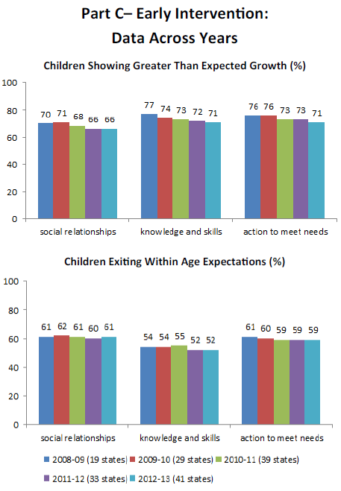
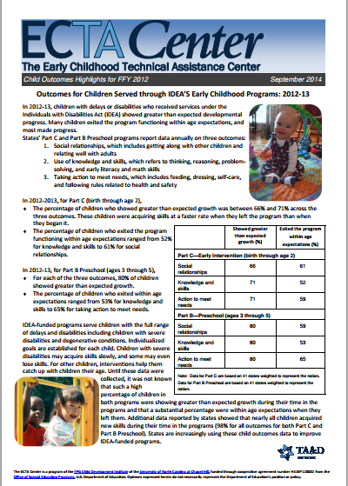
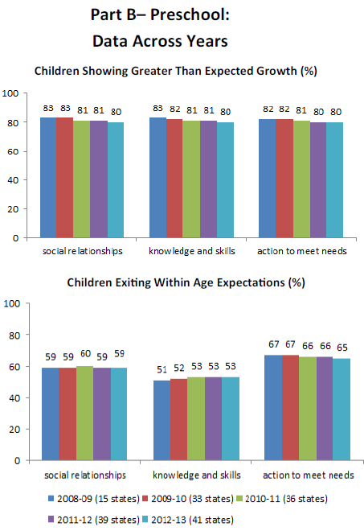
Most Recent Data
To access the most recent national summary of child outcomes data, visit: http://ectacenter.org/eco/assets/pdfs/childoutcomeshighlights.pdf
Notes:
Because for several years practitioners like you all over the country have been providing outcomes data, there is state-by-state and national information on children’s progress in early intervention and early childhood special education. We know what percentage of these children are performing like same-age peers and what percentage show greater than expected growth by the time they leave a program. And we know this for each of the three outcomes. Furthermore, because these data exist, the US Department of Education can provide Congress with evidence that the investment in these programs is money well spent.

Slide 15
Child Outcomes: Making a Difference
Early intervention and preschool special education strive to achieve the three outcomes for all children receiving services.
Gathering child outcomes data is an important part of the process that shows how a program can make more of a difference through continuous improvement.
Notes:
In summary, helping children improve in the three outcomes supports their full participation in their homes, schools, and communities. Data on the three child outcomes help us know whether early intervention and early childhood special education are making a difference for young children with delays and disabilities. Child outcomes data are an important tool for helping all programs become stronger. The data reveal what is needed for programs to keep improving. That’s why data are collected and why having good data is so important. The information supports good decision-making and program planning. It helps identify what works and what might work even better. It helps make a difference.

Slide 16
Closing
Click the back arrow to return to the module.

