Slide 1
Writing Tools: For you & you & you!
Marsye Kaplan, MS, CCC-SLP,ATP
Notes:
Hello,
Let’s take a look at writing tools that can benefit all of our students.

Slide 2
“Written language is the most complex aspect of language arts.”
Morris and Crump 1982
Notes:
As we try to consider writing and written language and how they impact our students Morris and Crump say it best in the quote offered. “Written language is the most complex aspect of language arts.

Slide 3
Writing Involves Many Skills
Handwriting: the physical act of getting words on paper.
Generation of ideas
Organization of ideas
Word Retrieval
Grammatical structures
Sentence construction
Knowledge of the reader’s perspective
Editing
Notes:
We know from working with our students that handwriting involves many skills. We see from this list this is only the beginning of the skill set that our students need to be proficient writers. We need to consider the physical act of getting words on paper. When a referral is made we need to tease out what they are looking for. Coming up with the ideas and then organizing them is a challenge. Retrieving information and using appropriate grammatical structures come into play when we are considering the writing process. The final considerations are editing and being aware of the reader’s perspective.
.

Slide 4
Student Challenges
During Writing process
  Lack understanding of purpose
  Fail to have a plan
  Spend less time writing
  Use immature/ineffective ‘knowledge telling’ strategy
  Lack strategies or procedures for generating
  Organizing ideas
  Do not know or use text structures
  Over rely on narrative or descriptive text structures
Perterson-Karlan, G. & Parette, H. Supporting Struggling Writers Using Technology
Evidence-Based Instruction and Decision-Making SEAT Center Nov. 2007
Notes:
Students often find the writing process challenging. They may have difficulty understanding the purpose for writing or just cannot come up with a plan. These students may spend less time on task or at the very least use immature strategies. Lack of organization and limited knowledge of the structure of writing are frequently evident.

Slide 5
Student Challenges
Composing
  More mechanical errors (spelling, punctuation, capitalization
  More subject predicate agreement errors (syntax)
  Fewer words, sentences, less variety of words, fewer adjectives and adverbs, fewer novel words and fewer words with at least seven words
  Less complex sentences
Perterson-Karlan, G. & Parette, H. Supporting Struggling Writers Using Technology
Evidence-Based Instruction and Decision-Making SEAT Center Nov. 2007
Notes:
With regard to composing, it is not uncommon to see errors in syntax and mechanics. Sentence complexity and length are also diminished.

Slide 6
Struggling Writers
Vary in their strengths and challenges.
Need to be thoroughly evaluated to identify where support is needed.
Often are aware of their problems and become discouraged reluctant writers.
Notes:
As with all individuals, these students will certainly vary in their abilities and needs. We need to evaluate thoroughly to determine where to begin instruction.
Do not be surprised to find out that many of these students are well aware of their challenges!

Slide 7
Challenges For Struggling Writers in Composition
Have more difficulty with composition.
  Distort word order, omit words.
  Use incorrect verbs, pronouns, and word endings.
  Have more difficulty with expository writing.
  Have deficits in working memory.
Notes:
A review of this slide illustrates the commonalities of challenges noted in composing.

Slide 8
Composition Challenges (Cont.)
Sentences are shorter and the number of sentences are fewer.
Have more difficulty with organization and planning and spend less time on these activities.
Are often the first one done and do not spend time editing.
Work strays from topic.
Notes:
In addition to these challenges already noted, these students are often the first one finished and when reviewing work, you will notice their inability to stay on topic.

Slide 9
Challenges in Mechanics
Spelling.
  Choose words that are safe & easy to spell
  Difficulty applying spelling rules
  Problems with spell checkers
    Word so poorly spelled - spell checker cannot identify the word
Capitalization and punctuation errors are frequent
Little variety in sentence structure
Notes:
Mechanics issues will be evident in spelling when the students regularly select the safe and easy words. Too often, their spelling is so challenged that even the spell checker can’t identify the word. Another characteristic is that there is very little variety in sentence structure.

Slide 10
Use of a Word Processor
Studies Have Shown That:
Does not impede the writing process
Does not interfere with idea generation.
More interested in the writing process
Editing less painful- no recopying
Easier revisions
  take more risks with words & length of composition
Notes:
Now that we have an ideal of the challenges, let begin thinking about solutions.
The first one that is often considered is the word processor. We know from research that using the word processor does not interfere with the writing process or generation of ideas. In some cases it is actually motivating. We want our students to take risks and write more.

Slide 11
Hetroni & Schrieber, 2004
Significant differences between handwritten and computer samples
Less spelling errors
More organization and structure
Fewer errors reading their own work
Negligible difference in # of words generated
Notes:
In a study by Hetroni and Schrieber, they found that when comparing writing and typing there were less spelling errors with better sentence structure and organization.

Slide 12
Important Points
Technology will not solve the problems alone.
Good teaching strategies must also be included.
Students must be taught the skills to use technology.
Sitting a child in front of a word processor does not make them instantly competent.
Notes:
As we consider technology, I want to be sure you understand that technology alone is not a fix. We still need good teaching and the students must be taught the skill set to be successful.

Slide 13
Current Demands
Increased writing in very early years
More time spent on composing and copying
Less time spent on handwriting
Increased writing demands at all grade levels
High stakes testing
Writing competencies to graduate from high school
Notes:
In recent years the educational environment has increased the demands for writing at an earlier age and at all grade levels. We see more time spent on composing and less on the physical writing component.

Slide 14
Assessment
Handwriting
  Speed
  Legibility
  Endurance
Keyboarding
  Speed
  Accuracy
  Endurance
Spelling
Writing traits
  Ideas
  Organization
  Voice
  Word choice
  Sentence fluency
  Compare to typical performance
Notes:
In the assessment process we need to take into consideration both handwriting, typing and of course the various writing traits.

Slide 15
Handwriting Issues
Not a problem
Problem
Legible to unfamiliar reader
Keep up with the pace of peers
Keep pace with his/her expression of ideas
Illegible to unfamiliar reader
Can’t keep pace with peers
Unable to keep pace with his/her expression of ideas
Difficulty with endurance for longer assignments
Notes:
Following the assessment, we will want to compare what is and is not a problem. Results that are legible to the unfamiliar reader, when a student can keep pace with peers both in the physical act as well as expression are not considered a problem. On the other hand, illegibility, pace and lack of endurance can be red flags.

Slide 16
Keyboarding Issues
Handwriting speed is considerably faster than typing
  keyboard is not an efficient tool.
Regular daily practice in keyboarding with a structured program can yield good results
  It is most effective if the student is practicing both at home and school
Notes:
It is often suggested that if we provide a student with a keyboard device, it will solve the problem. When handwriting is considerably faster than typing, keyboarding is not necessarily an efficient tool. We do suggest regular keyboard practice for these youngsters.

Slide 17
Keyboarding Issues (Cont.)
Composition speed of 6-10 words per min.
  sufficient for an EL school student.
  average adult composition speed is 18 WPM
Using a keyboard to take notes is a different skill than using a keyboard to compose.
Learning to compose on the computer versus paper is a new skill and must be given time to develop.
Notes:
How fast is fast or how slow is slow.
Composing on the keyboard at 6-10 words per minutes is sufficient for an elementary students, while 18 words per minutes is average for an adult.
Note taking is a major issue. Note taking requires that we listen, process and determine what needs to be written. Keyboarding is not a functional way for most students to take notes. Consider your own keyboarding skills. If you can take notes on the computer, how long did it take for you to build that skill?

Slide 18
Tools and Techniques That Can Help With Spelling
Personal Dictionary
Word Wall
Franklin Spell Checker
Word Spell Check
Talking Word Processor
Word Prediction Software
Notes:
The tools listed on this slide are just a few of the ideas that can support spelling. Personal dictionary, word wall, Franklin Speller, MS Word spell check, Write Out Loud- talking word processor and word prediction such as Co:Writer. You may want to think out of the box for additional strategies.

Slide 19
Word Prediction?
Benefit
Not Benefit
Writers with physical disabilities, especially those using switch access
Writers who lack skill and confidence in writing due to poor spelling and grammar
Slow typist
  Doesn’t speed up time
  interferes with the flow of typing
  Learning keyboarding is a better option
No beginning phonemic awareness
  Cannot predict without a beginning sound
Notes:
You must consider both the pros and cons of using word prediction. For students with physical disabilities or a language based writing disability, word predication might be the ticket. On the other hand if they are just slow typists or have significant issues with phonemic awareness, word prediction might not be the right solution.

Slide 20
Word Prediction
Co:Writer www.donjohnston.com
WordQ www.wordq.com
Kurzweil 3000 www.kurzweiledu.com
Clicker 6 www.cricksoft.com
Classroom Suite www.intellitools.com
  My Study Bar http://www.rsc-ne-scotland.ac.uk/eduapps/mystudybar.php
Notes:
This slide lists a number of word prediction resources. Take some time to check them out. It will be worth the time investment.

Slide 21
Tools and Techniques That Can Help With Organization and Composition
Graphic organizers
Inspiration/Kidspiration
Draft builder
Features on Microsoft word- reading level, find and replace, dictionary, & thesaurus
Notes:
Tools listed here can assist with organization and composition. Graphic organizers, Inspiration, Kidspiration, Draft Builder, features on Microsoft Word- reading level, find and replace, thesaurus.

Slide 22
Graphic Organizers
Brainstorming, Organizing, Writing Supports
Inspiration 8 www.inspiration.com
Kidspiration
Draft:Builder www.donjohnston.com
Kurzweil v.11 www.kurzweiledu.com
  My Study Bar http://www.rsc-ne-scotland.ac.uk/eduapps/mystudybar.php
Notes:
Graphic organizers are seen in both instructional and assistive technology. Do a little exploring. You may find these helpful even for yourself.

Slide 23

Tools and Techniques to Support Sentence Structure
Microsoft Word grammar check
Ginger Software
  www.gingersoftware.com
Talking word processors
Classroom Suite or Clicker 6 with word pallets/grids
Notes:
This slide highlights a number of tools that support sentence structure and grammatical structures.
The Ginger website offers an evaluation tool for grammatical assistance. Type in a sentence and it will tell you if you are correct or incorrect.
Talking word processors allow the student to hear what they wrote and make adjustments.
You will also want to check out the IntelliTools Classroom Suite and Crick software Clicker 6 to see how word grids and pallets can support the writing process.

Slide 24
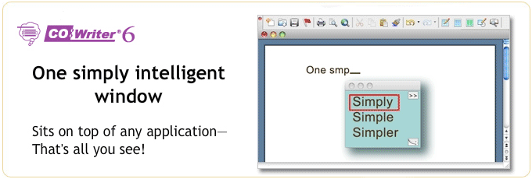
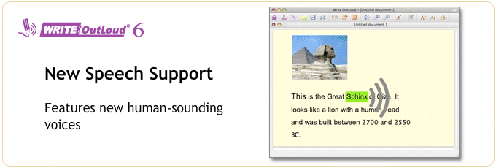
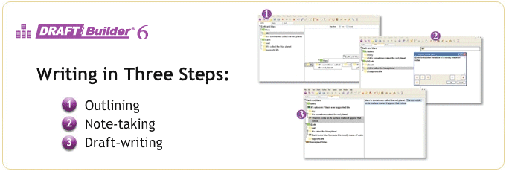
Don Johnston’s Writing Supports
Co: Writer 6
Write: Outloud
Draft:Builder
Notes:
Don Johnston’s writing supports:
Co:Writer: Word Prediction
We know from working with our students that handwriting involves many skills. We see from this list this is only the beginning of the skill set that our students need to be proficient writers. We need to consider the physical act of getting words on paper. When a referral is made we need to tease out what they are looking for. Coming up with the ideas and then organizing them is a challenge. Retrieving information and using appropriate grammatical structures come into play when we are considering the writing process. The final considerations are editing and being aware of the reader’s perspective.
Write:Outloud:
Talking Word Processor. Allows students to hear letter by letter, word after spacing or sentence after punctuating and spacing.
Draft:Builder:
Graphic organizer/outline program. This is a terrific support for the writing process
.

Slide 25
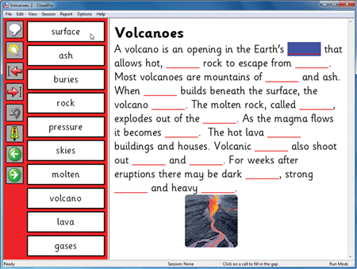

Cloze Pro www.cricksoft.com
Notes:
ClozePro, another Crick software program, is a software program that provides opportunities for Cloze activities. Teachers can customize the grid to include words, phrases and phonemic elements.

Slide 26
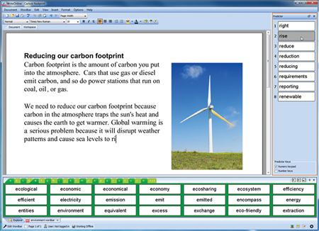
Write Online www.cricksoft.com
Notes:
WriteOnline is the innovative writing tool for schools and colleges. Word prediction, great quality speech, and the unique Wordbar help students of all abilities to achieve their full potential.

Slide 27

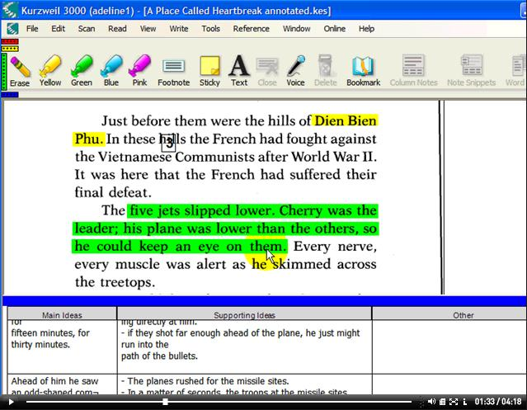
www.kurzweiledu.com
V.13 Writing Supports
Column notes
Notes:
Kurzweil 3000 provides a wide variety of writing supports including: note taking in the column note feature, talking word processor, and word prediction

Slide 28
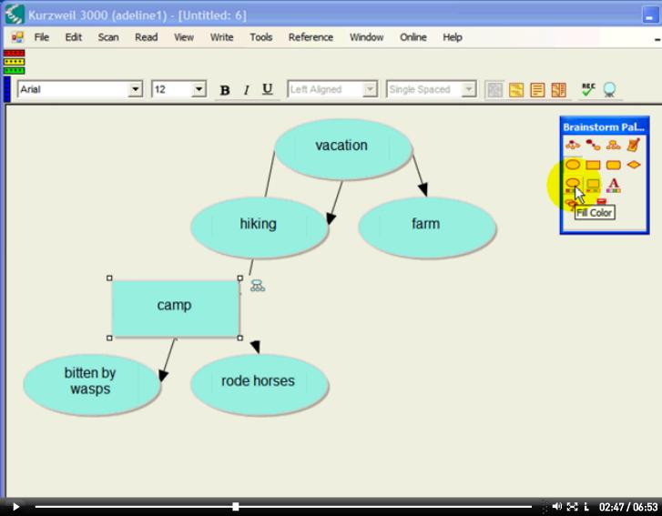
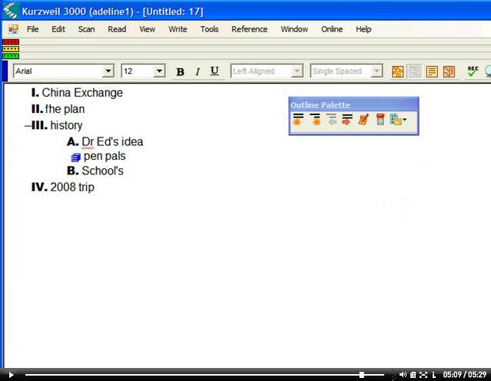
V.13 Writing Supports
Brainstorm
Outlining
Notes:
Here we see the graphic organizer and outlining feature of Kurzweil.

Slide 29
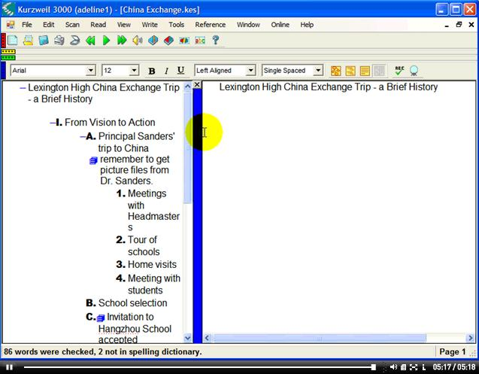
V.13 Writing Supports
Draft writing
Notes:
Following the writing process, Kurzweil offers a split screen for composing that all important draft.

Slide 30
Speech recognition
Windows 7
Dragon Naturally Speaking
Notes:
One of the newest strategies is speech recognition. Let’s take a look at two tools that allow you speak to the computer and have your text printed at the same time.

Slide 31

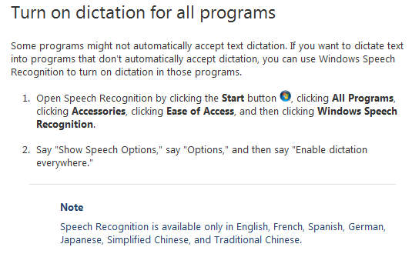
Microsoft Windows 7
Speech to Text
Notes:
The first programs that I want you to consider is Microsoft’s speech recognition or speech to text program. This program is built into the Windows 7 operating system. Imagine sitting at your computer speaking into a microphone and having all of the text appear magically on the screen. This program can open up the world to students who have difficulty with writing but who excel in speaking.

Slide 32


Speech Recognition
Dragon Naturally Speaking
Getting information down on paper
May not be the tool to generate paragraphs
Notes:
For those students who need a more robust program, Dragon Naturally Speaking is the programs for them.

Slide 33
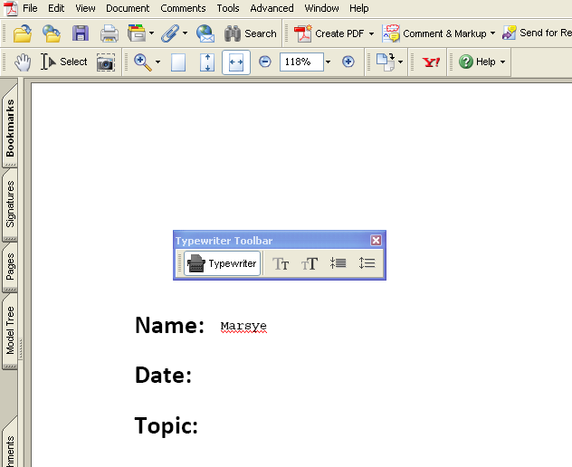
Adobe Acrobat Professional
PDF
Notes:
Did you know that Adobe acrobat professional allows you to write directly on the document. This program in most schools, readily available, and cost effective is a perfect alternative for many students.

Slide 34

Online Writing Resources
My Study Bar
  http://www.rsc-ne-scotland.ac.uk/eduapps/mystudybar.php
Write Online
  www.crick.com
Notes:
My study bar is a free resource from Scotland. The website on the slide provides you with a link that allows you to download this very cool tool directly onto your flash drive. Many school districts do not allow download of software. This program runs from a flash drive. An excellent choice.

Slide 35
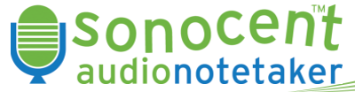
Audio Notetaker
Makes the audio file visual
Allows for editing
Work with audio file
  edit
http://www.audionotetaker.com/
Notes:
The audio note taker is a relatively new tool. It will allow you to make the audio file visual which allows for easy editing.

Slide 36
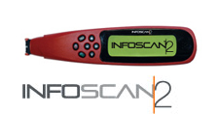


Notetaking Pens
InfoScanTM2
  Portable hand-held scanner
  Stores, transfers to PC
  20,000 lines -500 pages
  http://www.wizcomtech.com/eng/catalog/a/infoScan2/
C-Pen
  www.cpen.com
Iris Pen
  www.irislink.com
Notes:
There are a variety of note-taking pens on the market. Take a few minutes to explore the InfoScan, C-Pen or Iris Pen..

Slide 37
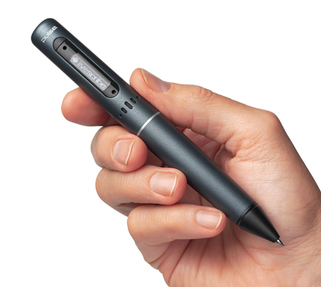
LiveScribe
Echo Pen
Automatically captures everything as you write and draw
Records audio and links it to what you write
  Tap on your notes or drawings
  hear what was said while you were writing.
Transfer your notes to your computer
Share Your Notes
  Upload online
  Transform notes and audio into interactive movies
Notes:
Let’s begin imagining sitting in a class taking notes and at the same time your pen is audio recording what is being said. The magical notebook allows you to the touch any location and hear exactly what your professor was saying. Imagine connecting this pen to your computer and uploading the audio as well as the text notes that you have just taken. An A in every class. Visit the Livescribe website to see how this echo pen can change the lives of students young and old. The Livescribe has many instructional benefits for teachers.

Slide 38
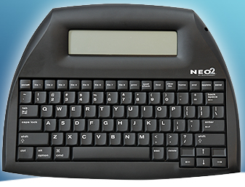
NEO2
Notes:
There are a variety of portable word processors on the market. One of those is called in the Neo. You may be familiar with the AlphaSmart technology. Neo is the newest member of th AlphaSmart family. Check out the website to see how this tool can meet the needs of students struggling with the writing process.

Slide 39
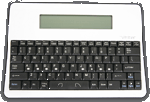

The Writer The Fusion/Forte http://www.writerlearning.com/special-needs/fusion.php
Word Processor
Keyboard tutorial
Word prediction
IR connection
Word processor
Text to speech
Word prediction
Thesaurus
IR connection
Notes:
Another set of portable word processors are the Writer and the Fusion or Forte`. The Writer is a basic word processor the Fusion or Forte`is a talking word processor.

Slide 40
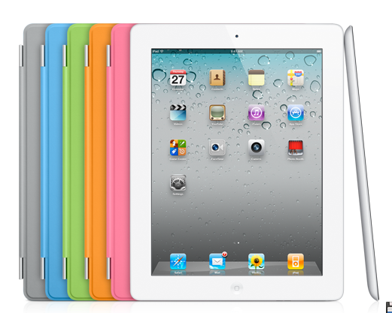
Mobile Digital Devices
Notes:
We could not move away from the writing supports without talking about mobile digital devices. Whether you are looking at the Kindle Fire or the iPad mobile digital devices are here to stay.

Slide 41
Apps for Writing
Dragon Naturally Speaking
Swype
Evernote
Pages
SolidNote
Notes
Office HD²
Notes:
This slide highlights a number of apps for writing .

Slide 42
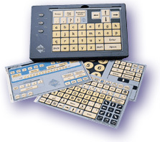
Tools and Techniques That Can Help With the Physical Act of Writing
Slant board
Pencil grips
Vertical surface
Trackball
IntelliKeys
Keyboarding devices
Computers
Notes:
Many of their students have physical disabilities that interfere with the act of writing. Whether they use a slant board or pencil grips and expanded touch sensitive keyboard such as the IntelliKeys or other keyboard devices we must consider all options to assist are struggling writers.

Slide 43
Summary
There are many challenges for struggling writers
It is important to identify what the issues are for a particular student
Consider the many low tech and high tech tools
Notes:
In summary, we know that many of our students struggle with the writing process whether for physical or cognitive reasons. We must identify the issues for that particular child and consider the range of low to high tech tools to support them.

