Slide 1
Excellence Counts in Early Learning and School Age Care
Notes:
Maryland EXCELS – EXCELS stands for Excellence Counts in Early Learning and School Age Care. Early learning is an all-encompassing term that refers to child care centers, family child care homes, large family child care homes, Head Start programs, Early Head Start programs, non-public nursery schools, public prekindergarten programs and school age only child care facilities.
Maryland EXCELS is a project of the State’s Race to the Top Early Learning Challenge Grant. The Johns Hopkins University Center for Technology in Education is a partner with the Division of Early Childhood Development at the Maryland State Department of Education.

Slide 2
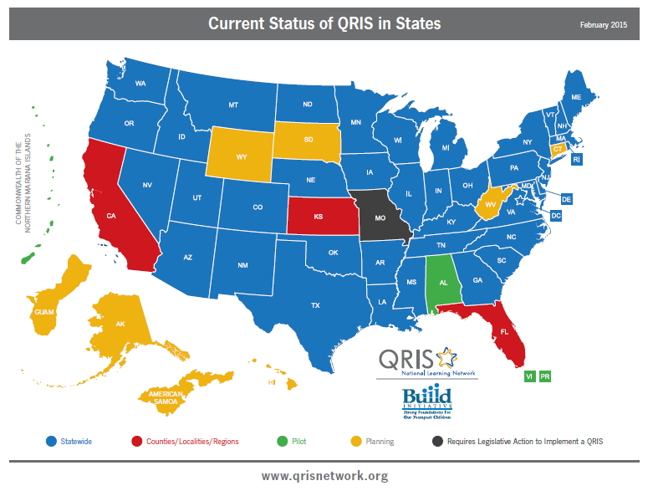
What is Maryland EXCELS?
Maryland EXCELS is a Tiered Quality Rating and Improvement System, which awards ratings to child care and public prekindergarten programs that meet increasingly higher standards in key areas of quality.
Notes:
Maryland EXCELS is a voluntary Tiered Quality Rating and Improvement System that emphasizes the need for self-evaluation, setting goals, developing curriculum, and using best practices to increase the level of quality in childcare and early education programs.
Over 50 Quality Rating and Improvement Systems across the nation have currently been implemented or piloted with new ones being created. (Refer to blue, red, and green areas of qrisnetwork.org State Contacts and Map).

Slide 3
What is Continuous Quality Improvement?
ASSESS
IMPROVE
COMMUNICATE
Notes:
“A quality rating system [like Maryland EXCELS] is guided by the vision of improving services to increase positive outcomes for children and families” (Linda Smith).*
Quality improvement is accomplished through a process of assessment, communication, and improvement
First, programs assess and document their strengths and areas for growth, using reliable tools and best practices included in the Maryland EXCELS standards.
Second, programs embark on a path of continuous quality improvement to strategically tackle the areas identified as opportunities for growth through the assessment process, with support and technical assistance.
Third, Maryland EXCELS ratings communicate to families the importance of quality child care and early education choices, helping them make informed decisions about the program their child attends.
* Linda K. Smith is the Deputy Assistant Secretary and Inter-Departmental Liaison for Early Childhood Development for the Administration for Children and Families (ACF) at the U.S. Department of Health and Human Services.

Slide 4
What are Maryland EXCELS Standards?
Licensing and Compliance
Rating Scales and Accreditation
Staff Qualifications and Professional Development
Developmentally Appropriate Learning and Practice
Administrative Policies and Practices
Notes:
The Maryland EXCELS standards in five content areas are based on nationally identified components of quality:
1) Licensing and Compliance is the foundation upon which Maryland EXCELS is built. Licensing regulations set the minimum standards by which child care facilities operate. Maryland EXCELS is a voluntary system and child care providers may choose to participate. In order to take subsidy vouchers (Child Care Subsidy), providers must participate.
2) Rating Scales and Accreditation
3) Staffing and Professional Development
4) Developmentally Appropriate Learning and Practice; and
5) Administrative Policies and Practices.

Slide 5
Accreditation and Rating Scales (ACR)
ACR |  |  | CHECK LEVELS
 |  |  | 1 | 2 | 3 | 4 | 5
ACCREDITATION | ACR 1 | Accreditation |  | ACR 1.2 Within the past 12 months, the Director or designated staff person has completed MSDE approved Accreditation Training. | ACR 1.3 Within the past 12 months, the Director or designated staff person has visited or had a conversation with a child care program accredited by an organization recognized by MSDE. | ACR 1.4 Accreditation self-study completed and validation visit requested. | ACR 1.5 Accreditation awarded by an organization recognized by MSDE and program remains in good standing with accrediting body.
 | Doc |  |  | Accreditation Reflection and Planning form | Accreditation Visit Verification form | Documentation from accrediting organization that visit has been requested | Letter or certificate of accreditation award, documentation from accrediting organization that annual report has been received
RATING SCALE | ACR 2 | Classroom Assessment |  |  | ACR 2.3 Self-assessment conducted using ERS or CLASS for at least one classroom from each age group as defined by the scales. | ACR 2.4 ERS or CLASS conducted by an approved assessor according to the schedule established by MSDE for at least one classroom from each age group as defined by the scales. | ACR 2.5 ERS or CLASS conducted by an approved assessor according to the schedule established by MSDE for at least one classroom from each age group as defined by the scales.
 | Doc |  |  |  | Rating Scale Score Sheet(s) | Rating Scale Score Sheet completed by MSDE | Rating Scale Score Sheet completed by MSDE assessor
Check Level
Content Area
Criteria
Category
Documentation
Notes:
This chart helps users interpret the standards. There are separate standards for Family Child Care, Child Care Centers, School-Age Only Programs and Public PreKindergarten. Large Family Child Care Homes use the Family Child Care standards. Head Start and Non-Public Nursery Schools use the Child Care Center standards.
Each chart is organized for easy reference. The content areas appear as the heading with the check level – 1 through 5 – underneath. To the left side are the categories. For each category, there are criteria that increase across the levels. Finally, the red type denotes the documentation required to verify or validate that the facility has met the criteria.

Slide 6
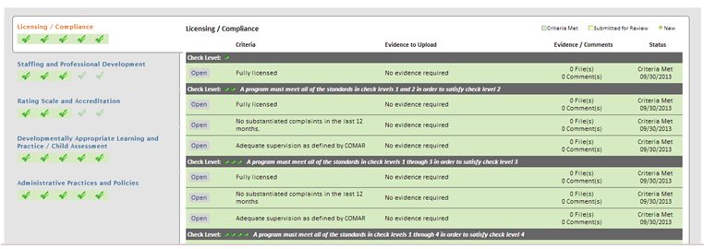
Online View of Standards
Maryland EXCELS is a block rating system.
Overall check level rating is based on the highest level
achieved in each content area.
Notes:
When programs and providers access the Maryland EXCELS online system to register and begin an application, the standards are laid out a bit differently for ease of online viewing, as you can see here. That means that a program’s overall check level rating is based on meeting all criteria for a specified level.

Slide 7
Achievements
Asthma Friendly Child Care
Health and Wellness
Quality Business Practices Program Administration Scale (PAS) Business Administration Scale (BAS)
Cultural and Linguistic Competency
Eco Friendly Program
Notes:
Maryland EXCELS recognizes child care and public PreKindergarten programs that provide services over and above those outlined in the standards. Programs that are recognized for these additional achievements are acknowledged on the Maryland EXCELS web site and in the Quality Finder Mobile App.
Current additional achievements include:
Asthma Friendly Child Care
Health and Wellness
Quality Business Practices (which refers to the successful completion of PAS or BAS training), and
Cultural and Linguistic Competency
Eco Friendly Program
For more information on how your program can be recognized for these Additional Achievements, please see the flyer available in the Resources section of www.marylandexcels.org

Slide 8
www.MarylandEXCELS.org
Notes:
To participate in Maryland EXCELS, programs and providers visit the web site: marylandexcels.org to register and submit an online application.
It’s important to note that registering on marylandexcels.org by creating a User Name and Password is only the first step, but an important one! Completing and submitting the online application is next.
When the application is complete and accepted, an email confirmation will assign a Program Coordinator and provide contact information for the Quality Assurance Specialist. Programs can then begin working within the Maryland EXCELS online system to upload documentation to meet the standards and achieve a quality rating. Participating programs must publish a rating after acceptance in Maryland EXCELS.

Slide 9
Tech Support
Notes:
For help with the system, email or call 24-hours a day, 7 days a week for personalized care.

Slide 10
Supporting High Quality
Bonuses
Credentialing Specialists
Discounts
Tiered Reimbursement
Resource and Referral Staff
Program Coordinators
Quality Assurance Specialists
Notes:
When programs choose to participate in Maryland EXCELS, they receive multiple sources of support – from the Program Coordinator, to Quality Assurance Specialists, a Credentialing Liaison, and the Resource and Referral network staff. Programs participating in Maryland EXCELS also receive access to discounted memberships, supplies, and trainings [a current list is available at marylandexcels.org].
Programs participating receive a variety of financial incentives connected with participation in Maryland EXCELS, including program bonuses, which are awarded upon achievement and publishing of a check level.

Slide 11
Quality Assurance Specialists
For a list of Quality Assurance Specialists, visit www.MarylandEXCELS.org
Dianna C. Aguirre
Yvonne Bell
Sara R. Martin
Information to programs and groups about Maryland EXCELS
Regional and on-site consultation and support
Monitoring visits for Maryland EXCELS programs
Notes:
Fifteen Maryland EXCELS Quality Assurance Specialists are located in every regional licensing office throughout the state. More than one specialist has been assigned to regions with larger populations of providers.
Their responsibilities include:
Providing information to programs and groups about Maryland EXCELS;
Engaging local organizations – Judy Centers, Resource and Referral Centers, other local groups and key people;
Identifying programs that may be ready to move into EXCELS, including accredited programs, and helping to familiarize them with the standards and the online process;
Providing technical assistance, on-site consultation, and support; and
Conducting monitoring visits to Maryland EXCELS programs.
Find your region’s quality assurance specialists by visiting www.marylandexcels.org

Slide 12
How Continuous Improvement Happens
Programs and providers…
Learn what quality looks like
Develop and Implement a Program Improvement Plan
Have ratings verified and receive support when needed
Notes:
Maryland EXCELS promotes continuous quality improvement through the standards, which require that programs and providers at all check levels:
Learn to recognize best practice through a system of increasing expectations as they move through the quality levels. This learning takes place through technical assistance, accreditation, self-assessment, and/or outside assessment by an approved Environment Rating Scale (ERS) and/or Classroom Assessment Scoring System (CLASS) assessor.
Programs create an annual Program Improvement Plan informed by assessments, school readiness goals, and program priorities.
Maryland EXCELS Quality Assurance Specialists conduct monitoring visits to verify the program’s check level rating and provide support and technical assistance for ongoing improvement.

Slide 13
Family Outreach
Get on the Maryland EXCELS bus . . .
Flyers in English and Spanish, distributed in hard copy and online
FREE Maryland EXCELS Mobile App
Articles in local newspapers and organizational newsletters
Bus, Metro, and light rail ads in several counties
Notes:
This outreach effort includes:
colorful flyers and posters in English and Spanish are distributed statewide and available online;
family-friendly information and tools on marylandexcels.org web site, including the release of the new Maryland EXCELS Quality Finder Mobile App for FREE download;
articles in local newspapers and organizational newsletters (including Parent Teacher Associations) throughout the state; and
bus, light rail and Metro ads to run in Baltimore City, Baltimore County, Montgomery County, Frederick, Anne Arundel, Prince George’s and Howard Counties.
The goals of the campaign are to raise awareness about what quality child care and early education looks like, describe how programs and providers exhibit quality through the Maryland EXCELS check level system, and drive traffic to www.marylandexcels.org to help families search for published programs.

Slide 14
Expanded View for Families
Overall Published Rating
Additional Achievements (if applicable)
Rating in Each Content Area
Notes:
The expanded view shows the overall published check level, the program’s rating in each individual content area, as well as Additional Achievements (if the program is recognized in any of these areas).

Slide 15
Tools for Families
Quality Finder Mobile App
Flyers, Brochures, Handouts
Notes:
Here are some examples of the new information and tools available on www.marylandexcels.org for families: a flyer summarizing the Check Level Rating System and the difference between the levels and the new Quality Finder mobile App, which families can download for free and use to search for published programs in their area.
[Clicking on the phone takes you to the mobile app download]

Slide 16
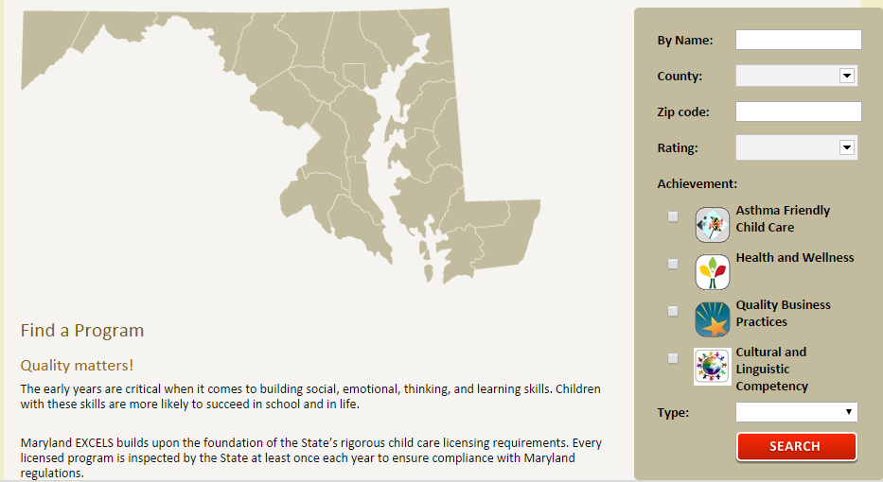
Find a Participating Program
Click on Find a Program on www.marylandexcels.org
Download the Maryland EXCELS mobile app and click on Find a Program
Visit Maryland Family Network’s LOCATE Child Care site at www.marylandfamilynetwork.org or call toll-free 877-261-0060.
Notes:
The purpose of the Child Care Subsidy (CCS) Program is to provide financial assistance with child care costs to eligible families. The CCS Program issues vouchers to eligible families in need of help with the cost of child care. To receive this assistance, families must meet certain requirements. In addition to help with the cost of child care, families can receive help locating a licensed child care provider.
After July 1, 2015, child care providers much be participating in Maryland EXCELS to accept a Child Care Subsidy voucher. To find a participating provider, contact LOCATE: Child Care or ask your prospective or current provider.
Informal Child Care providers are ineligible for Maryland EXCELS and their reimbursement is not affected.

Slide 17
Maryland EXCELS Videos
For Providers and Programs
For Families
Notes:
The first video: https://www.youtube.com/watch?v=xZoAQwG7Z1w&feature=youtu.be
The second: https://www.youtube.com/watch?v=bYMtElNgA8w&feature=youtu.be

